Slide 1
Interventions to prevent and reduce gender-based violence among young people living with, or most affected by, HIV in low-and middle income countries
A systematic review and meta-analysis
Franziska Meinck, Marija Pantelic, Madison Little, Vasileios Nittas, Amy Bustamam, Vanessa Picker, Luisa Orza, Thees Spreckelsen & Heidi Stöckl
#AIDS2018 #WeAreREADY #FreshVoicesMakingChoices @theaidsalliance

Slide 2
Background
GBV is associated with risk of HIV infection (Jewkes et al., 2010; WHO & UNAIDS 2013)
Young women are at particular risk for GBV and HIV (McPhail et al., 2015)
GBV is also associated with disrupted treatment for HIV (Hatcher et al., 2015)
28% of female adolescents and 29% of female youth in LMIC have experienced GBV in their lifetime (Decker et al., 2015)

Slide 3
Aims & Scope
P | Adolescents and youth aged 10-24 Living with, or affected by HIV In low and middle income countries
I | Interventions aiming to address gender-based violence
C | Compared to no intervention/ treatment as usual/ waitlist control or a different intervention…
O | Exposure to gender-based violence Perpetration Harmful gender norms

Slide 4
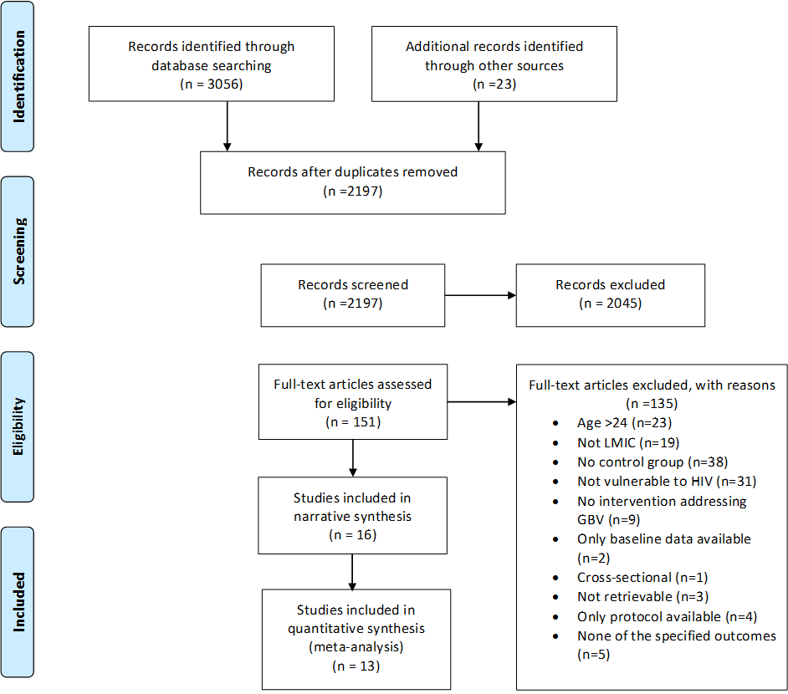

Slide 5
Study Characteristics
7 cRCTs, 2 RCTs, 7 non-randomised studies
Female (n=9), male (n=1), both sexes (n=5), reported only on females (n=1)
N=21,678 adolescents and youth
No key populations – only HIV-affected youth
Baseline perpetration of GBV 14.5%-59.8%
Baseline GBV exposure 4.5% - 31.4%
Countries: South Africa, Uganda, Kenya, Ethiopia, Zimbabwe and Brazil
#AIDS2018 #WeAreREADY #FreshVoicesMakingChoices @theaidsalliance

Slide 6
Youth involvement in GBV research

Slide 7
Interventions
Group-based and multi-component except cash-transfers and savings accounts
Used active discussions and knowledge acquisition
50% school-based, 50% community-based
Community involvement (n=3)
Youth involvement in intervention development (n=1)
#AIDS2018 #WeAreREADY #FreshVoicesMakingChoices @theaidsalliance

Slide 8
Intervention components and effectiveness
Notes:
These are classified by dominant components – for this slide I have vocational with psycho-educational because that is how all of these worked. The economic interventions are 1 conditional cash transfer, and 1 two-armed study savings accounts plus SRH and only savings accounts (which was the study which increased GBV)

Slide 9
Meta-Analyses by outcome
Outcome | Number of Studies | Overall effect & CI | Heterogeneity
Any GBV (both sexes) | 11 | 0.75 (0.61-0.93) | 83%
Any GBV (females) | 8 | 0.76 (0.50 – 1.15) | 94.1%
Any Sexual Violence (both sexes) | 7 | 0.78 (0.55-1.10) | 86.6%
Any Sexual Violence (females) | 5 | 0.88 (0.48-1.65) | 95.5%
Any Physical IPV (females) | 2 | 0.50 (0.43-0.57) | 0%
GBV perpetration (males) | 2 | 1.02 (0.48-2.17) | 83%
Gender norms (both sexes) | 3 | 1.19 (1.03-1.39) | 50.9%
NB: All except Physical IPV are multi-level random effects meta-analyses
#AIDS2018 #WeAreREADY #FreshVoicesMakingChoices @theaidsalliance
Notes:
The highlighted ones show a significant effect. Note also that there is very high heterogeneity for most outcomes. So that’s something to mention here.
Both sexes means that we included all studies that had only females, the one study that had only males and the overall effect for the studies with mixed samples. Unfortunately most of them (except 1) did not disaggregated their effect by sex so we don’t know what may be driving these overall reductions.

Slide 10
Conclusions
Interventions do not show large effects, if any
No effects on sexual violence or perpetration
Focus is mostly on girls protecting themselves
Most interventions are psycho-educational/ psycho-educational+
Interventions with self-defense component potentially most effective?
No rigorous evaluations with key populations
Interventions were not co-designed with young people
#AIDS2018 #WeAreREADY #FreshVoicesMakingChoices @theaidsalliance
Notes:
The highlighted ones show a significant effect. Note also that there is very high heterogeneity for most outcomes. So that’s something to mention here.
Both sexes means that we included all studies that had only females, the one study that had only males and the overall effect for the studies with mixed samples. Unfortunately most of them (except 1) did not disaggregated their effect by sex so we don’t know what may be driving these overall reductions.

Slide 11
Research gaps
Studies with key populations
Studies with HIV+ youth
Studies involving wider community
Studies focused on emotional and economic IPV
Meaningful involvement of youth in design of interventions
Studies focusing on prevention of perpetration rather than prevention of violence experience
#AIDS2018 #WeAreREADY #FreshVoicesMakingChoices @theaidsalliance
Notes:
The highlighted ones show a significant effect. Note also that there is very high heterogeneity for most outcomes. So that’s something to mention here.
Both sexes means that we included all studies that had only females, the one study that had only males and the overall effect for the studies with mixed samples. Unfortunately most of them (except 1) did not disaggregated their effect by sex so we don’t know what may be driving these overall reductions.

Slide 12
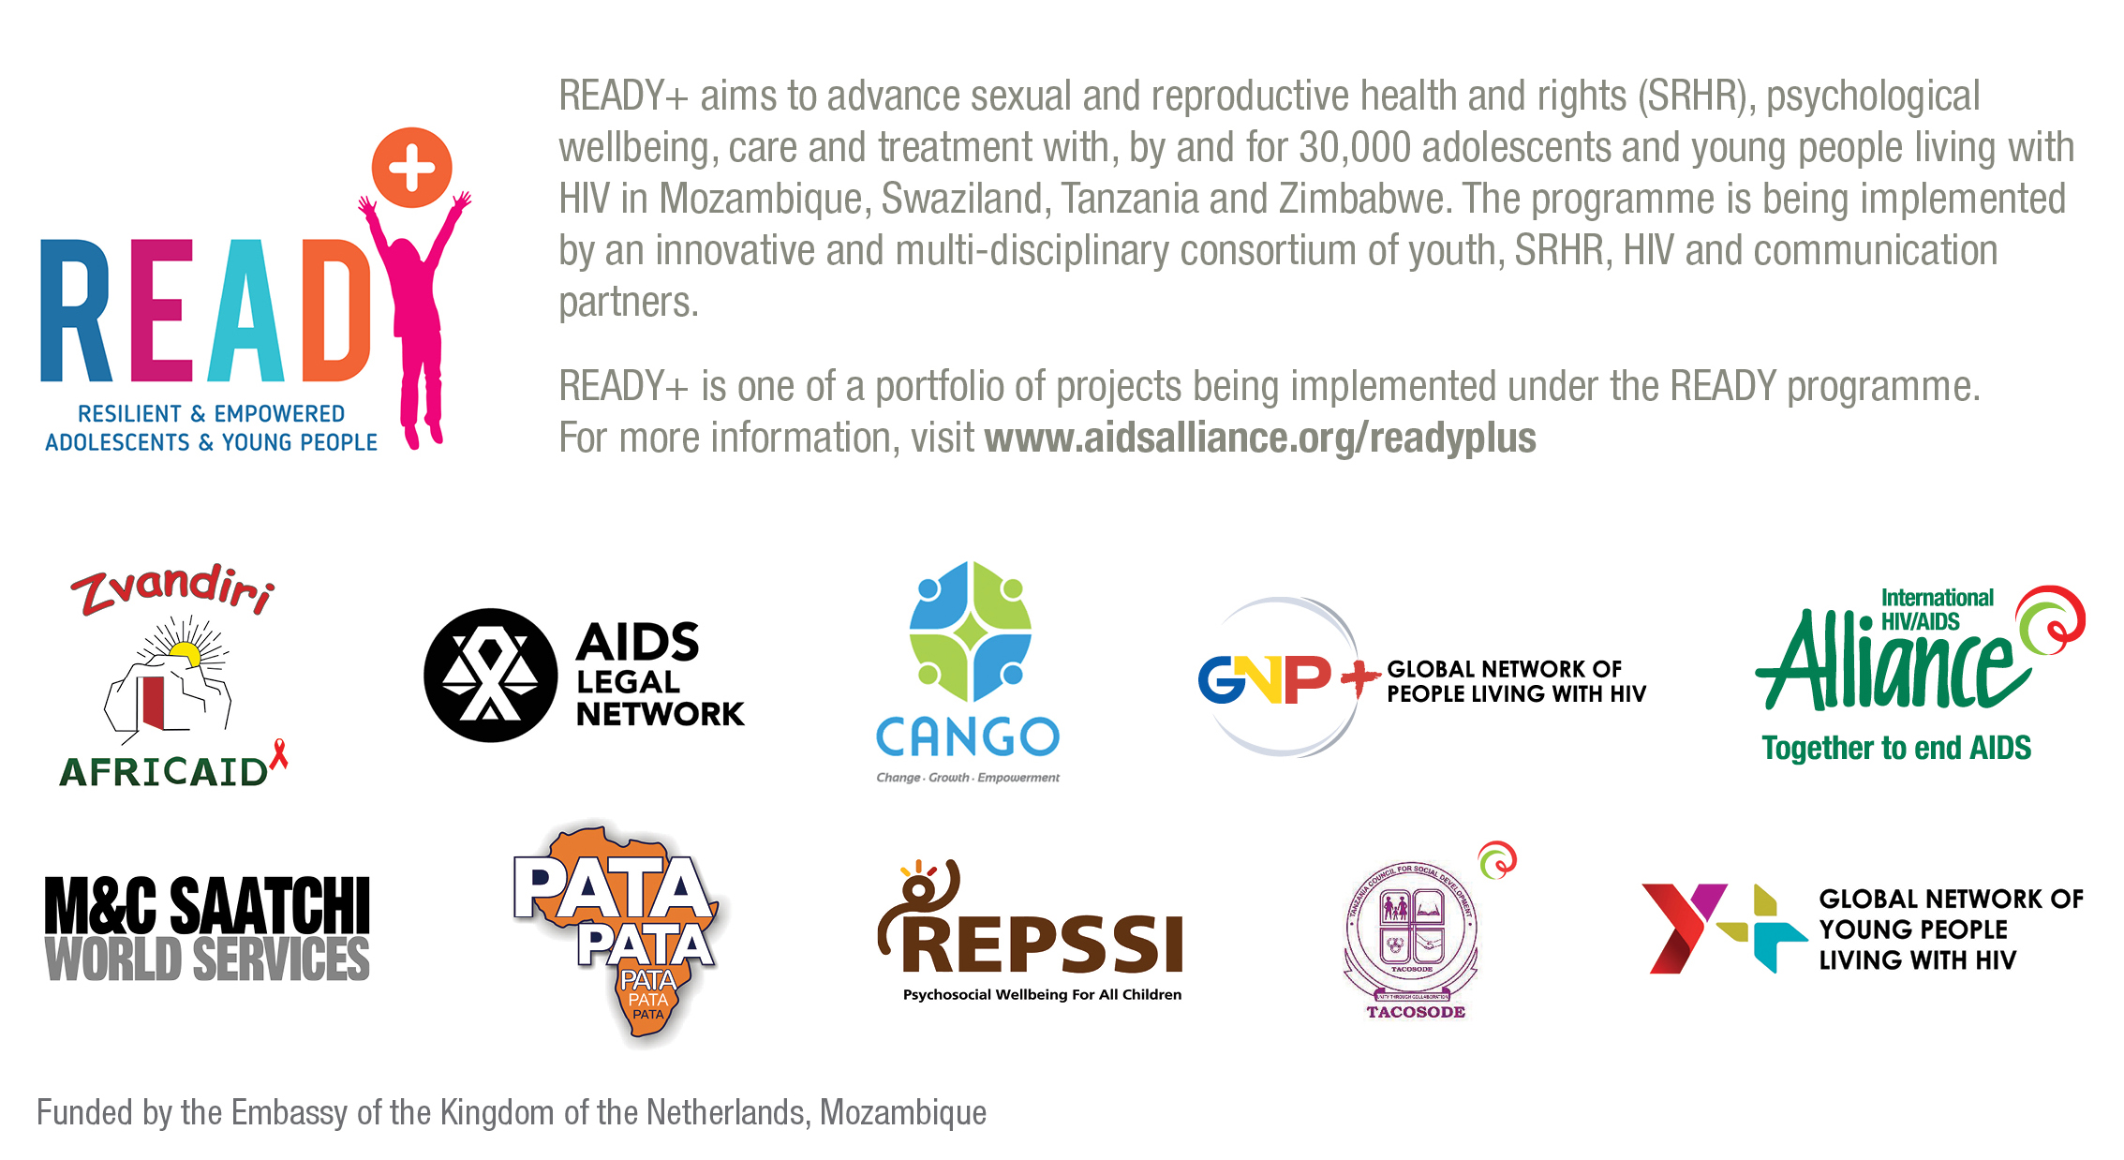
Thank you to our partners and funders!
#AIDS2018 #WeAreREADY #FreshVoicesMakingChoices @theaidsalliance

Slide 13
Methodological Appendices

Slide 14
Outcome and population definitions
GBV:
Intimate partner violence (physical, sexual, emotional or economical)
Non partner sexual violence directed at an individual such as unwanted touching or intercourse
Young people living with or most affected by HIV:
Key populations: MSM, LGBT, sex workers, injecting drug users
AIDS-affected: young people living in countries with high HIV prevalence or in a family affected by AIDS

Slide 15
Methods
13 databases, conference abstracts, trial registries, hand searches, e-mails to authors
Comprehensive search strategy
Meta-analysis:
Transformed all effect sizes into log OR
Where 2 intervention arms used combined weighted ORs
Random effects meta-analysis (multi-level if multiple outcomes)

Slide 16
Searches
Time Frame: 1982 until 17th January 2018
Databases: PsycInfo, Medline, Gobal health, Dissertation Abstracts, IBSS, ASSIA, Sociological Abstracts, Scopus, Social Sciences Citation Index, Sexual Violence Initiative, 3ie, K4Health and Google Scholar.
Conference abstracts: Sexual Violence Initiative, AIDS Impact, International AIDS Conference
Hand searches: WHO, UNAIDS, Un Women, UNFPA, Popline, International HIV/AIDS Alliance, USAID Development Experience Clearing House, DFID, preventviolence.info, UNICEF Innocenti, Salamander Trust and WhatWorks
Clinical Trial Registries: clinicaltrials.gov, PACTR, EU Clinical Trial Registry, Brazilian Clinical Trials Registry, Cuban Public Registry of Clinical Trials and Thai Clinical Trials Registry
Contacted authors

Slide 17
Search strategy
((Developing countries) OR (Africa OR Central Africa OR Latin America OR Caribbean OR West Indies OR Eastern Europe OR Soviet OR South America OR Arab OR Middle East OR Latin America OR Central America) OR (Afghanistan OR Albania OR Algeria OR Angola OR Antigua OR Barbuda OR Argentina OR Armenia OR Armenian OR Aruba OR Azerbaijan OR Bahrain OR Bangladesh OR Barbados OR Benin OR Byelarus OR Byelorussian OR Belarus OR Belorussian OR Belorussia OR Belize OR Bhutan OR Bolivia OR Bosnia OR Herzegovina OR Hercegovina OR Botswana OR Brasil OR Brazil OR Bulgaria OR Burkina Faso OR Burkina Fasso OR Upper Volta OR Burundi OR Urundi OR Cambodia OR Khmer Republic OR Kampuchea OR Cameroon OR Cameroons OR Cameron OR Camerons OR Cape Verde OR Central African Republic OR Chad OR Chile OR China OR Colombia OR Comoros OR Comoro Islands OR Comores OR Mayotte OR Congo OR Zaire OR Costa Rica OR Cote dIvoire OR Ivory Coast OR Croatia OR Cuba OR Cyprus OR Czechoslovakia OR Czech Republic OR Slovakia OR Slovak Republic OR Djibouti OR French Somaliland OR Dominica OR Dominican Republic OR East Timor OR East Timur OR Timor Leste OR Ecuador OR Egypt OR United Arab Republic OR El Salvador OR Eritrea OR Estonia OR Ethiopia OR Fiji OR Gabon OR Gabonese Republic OR Gambia OR Gaza OR Georgia Republic OR Georgian Republic OR Ghana OR Gold Coast OR Greece OR Grenada OR Guatemala OR Guinea OR Guam OR Guiana OR Guyana OR Haiti OR Honduras OR Hungary OR India OR Maldives OR Indonesia OR Iran OR Iraq OR Isle of Man OR Jamaica OR Jordan OR Kazakhstan OR Kazakh OR Kenya OR Kiribati OR Korea OR Kosovo OR Kyrgyzstan OR Kirghizia OR Kyrgyz Republic OR Kirghiz OR Kirgizstan OR Lao PDR OR Laos OR Latvia OR Lebanon OR Lesotho OR Basutoland OR Liberia OR Libya OR Lithuania OR Macedonia OR Madagascar OR Malagasy Republic OR Malaysia OR Malaya OR Malay OR Sabah OR Sarawak OR Malawi OR Nyasaland OR Mali OR Malta OR Marshall Islands OR Mauritania OR Mauritius OR Agalega Islands OR Mexico OR Micronesia OR Middle East OR Moldova OR Moldovia OR Moldovian OR Mongolia OR Montenegro OR Morocco OR Ifni OR Mozambique OR Myanmar OR Myanma OR Burma OR Namibia OR Nepal OR Netherlands Antilles OR New Caledonia OR Nicaragua OR Niger OR Nigeria OR Northern Mariana Islands OR Oman OR Muscat OR Pakistan OR Palau OR Palestine OR Panama OR Paraguay OR Peru OR Philippines OR Philipines OR Phillipines OR Phillippines OR Poland OR Portugal OR Puerto Rico OR Romania OR Rumania OR Roumania OR Russia OR Russian OR Rwanda OR Ruanda OR Saint Kitts OR St Kitts OR Nevis OR Saint Lucia OR St Lucia OR Saint Vincent OR St Vincent OR Grenadines OR Samoa OR Samoan Islands OR Navigator Island OR Navigator Islands OR Sao Tome OR Saudi Arabia OR Senegal OR Serbia OR Montenegro OR Seychelles OR Sierra Leone OR Slovenia OR Sri Lanka OR Ceylon OR Solomon Islands OR Somalia OR South Africa OR Sudan OR Suriname OR Surinam OR Swaziland OR Syria OR Tajikistan OR Tadzhikistan OR Tadjikistan OR Tadzhik OR Tanzania OR Thailand OR Togo OR Togolese Republic OR Tonga OR Trinidad OR Tobago OR Tunisia OR Turkey OR Turkmenistan OR Turkmen OR Uganda OR Ukraine OR Uruguay OR USSR OR Soviet Union OR Union of Soviet Socialist Republics OR Uzbekistan OR Uzbek OR Vanuatu OR New Hebrides OR Venezuela OR Vietnam OR Viet Nam OR West Bank OR Yemen OR Yugoslavia OR Zambia OR Zimbabwe OR Rhodesia) OR (low adj3 middle adj1 countr*) OR (lmic OR lmics OR third world OR lami countr*) OR (transitional countr* OR emerging market* OR emerging countr*) OR (low adj3 middle adj1 countr*) OR (lmic OR lmics OR third world OR lami countr*) OR (transitional countr* OR emerging market* OR emerging countr*)))) AND
(("gender-based" OR "gender based" OR "intimate-partner" OR "intimate partner" OR domestic OR dating OR sexual OR physical OR emotional OR economic OR psychological OR spousal) AND (violence OR maltreat* OR aggress* OR assault OR beat* OR abuse* OR batter*)) OR (GBV OR IPV OR "child marriage" OR rape OR "violence against women")) AND
(("sex work" OR "sex workers" OR prostitut* OR brothel* OR ((escort OR sex) adj3 buy*) OR (commercial adj3 sex*) OR (sex adj3 industry) OR (heteroflexible OR homosexual* OR homosexualit* OR gay* OR MSM OR "men who have sex with men" OR bisexual)) OR (stimulant* OR polydrug* OR drug* OR substance) OR (prison* OR jail* OR penitentiar* OR bastile* OR offender* OR reoffend* OR convict OR convicts OR convicted OR inmate* OR detainee* OR cellmate* OR incarcarated OR incarcaration OR felon* OR criminal* OR men OR women OR male OR female)
AND (teen* OR youth OR adolescent* OR "young people" OR "young adult*") AND
ti((Intervention* OR program* OR prevention OR policy OR policies))

Slide 18
Selection criteria
2 reviewers screened titles, abstracts and articles independently
Population | Adolescents and young people aged 10-24 living in a LMIC, living with HIV or belonging to a community disproportionately affected by HIV
Intervention | All interventions which aim to address or measure experiences of GBV or attitudes to GBV as an outcome
Comparator | Active and inactive controls: waitlist control, treatment as usual, placebo or other GBV intervention – study must have a control group
Outcomes | Primary: physical, emotional, sexual and economic IPV or sexual violence by a non-intimate partner Secondary: gender attitudes and social norms re. gender
Time | Short or long-term, important that outcomes measured at baseline and post-intervention

Slide 20
Randomised trials
Author, Year | Design | Sample size | Population | Intervention | Outcomes
Baiocchi, 2017 | Cluster RCT | 32 schools, n=6356 | School-going girls aged 10-16, KEN | Multi-component Girls: communication, relationships, self-defence, de-escalation Boys: gender norms, use of verbal interventions in harassment | Rape
Bandiera, 2017 | Cluster RCT | 150 villages, n=5966 | Girls aged 14-20, UGA | Multi-component Mentoring, vocational skills, SRH | Rape
Devries, 2017 | Cluster RCT | 42 schools, n=4138 | School-going children aged 11-14, UGA | Multi-component Safer schools, relationships, safer environment | Sexual violence
Dunbar, 2014 | RCT | N=315 | Orphaned girls aged 16-19, ZWE | Multi-component SRH, financial literacy, vocational skills, social support | Physical and sexual IPV
Jewkes, 2008 | Cluster RCT | 70 clusters, n=2776 | Men and women aged 16-23, ZAF | Multi-component SRH, GBV, gender norms, communication skills | Sexual or physical IPV exposure women/ men perpetration
Jewkes, 2017 | Cluster RCT | 24 schools, n=3411 | School-going children aged 12-19, ZAF | Multi-component A: Safer schools, human rights, communication, conflict resolution B: Above plus parenting intervention | Sexual or physical IPV exposure women/ men perpetration Gender norms
Kilburn, 2018 | RCT | N=2348 | School-going girls aged 13-20, ZAF | Conditional cash transfer | Physical IPV Sexual IPV
Mathews, 2016 | Cluster RCT | 42 schools, n=3451 | School-going children aged 12-19, ZAF | Multi-component SHR, communication, gender norms, IPV, safer schools, risk mapping | Physical, emotional and sexual IPV exposure and perpetration Unwillingness at first sex
Taylor, 2011 | Cluster RCT | 16 schools, n=818 | School-going children aged 12-19, ZAF | Multi-component Gender norms, relationships, SRH, human rights | Physical and verbal IPV, forced sex

Slide 21
Non-randomised studies
Author, Year | Design | Sample size | Population | Intervention | Outcomes
Austrian, 2014 | Pre-post with non-randomly allocated control | 1064 | Girls aged 10-19 in UGA | A: Multi-component Safe spaces, SRH, financial education, savings account B: Savings account | Sexual assault
Erulkar, 2005 | Longitudinal study with matched controls | 652 | Out of school girls aged 16-22, KEN | Multi-component Savings, micro credit, SRH, business training, life skills, mentoring | Gender norms Ability to refuse sex with partner
Pulerwitz, 2015 | Quasi-experimental, random assignment of subcities | 3, sub-cities, n=645 | Men aged 15-24, ETH | Multi-component Community engagement, HIV prevention, gender norms | Gender equitable norms Physical, sexual and emotional IPV
Rijsdijk, 2011 | Quasi-experimental, matched schools | 48 schools, n=1864 | School-going children aged 12-19, UGA | Multi-component SRH, gender norms, empowerment | Attitudes towards sexual coercion
Rocha, 2013 | Quasi-experimental, matched geographic locations | 2 neighbour-hoods, n=261 | Women aged 14-24, BRA | Multi-component Gender norms/GBV, SRH | Gender equitable attitudes Acceptance of domestic violence
Sarnquist, 2014 | Two cross-sections | 5 villages, n=2406 | School-going girls aged 13-20, KEN | Multi-component Self-defence, de-escalation, empowerment | Forced sex
Sinclair, 2013 | Census-based longitudinal cohort | 10 schools, n=522 | School –going girls aged 14-21, KEN | Multi-component Empowerment, de-escalation, self-defence | Sexual assault

Slide 22
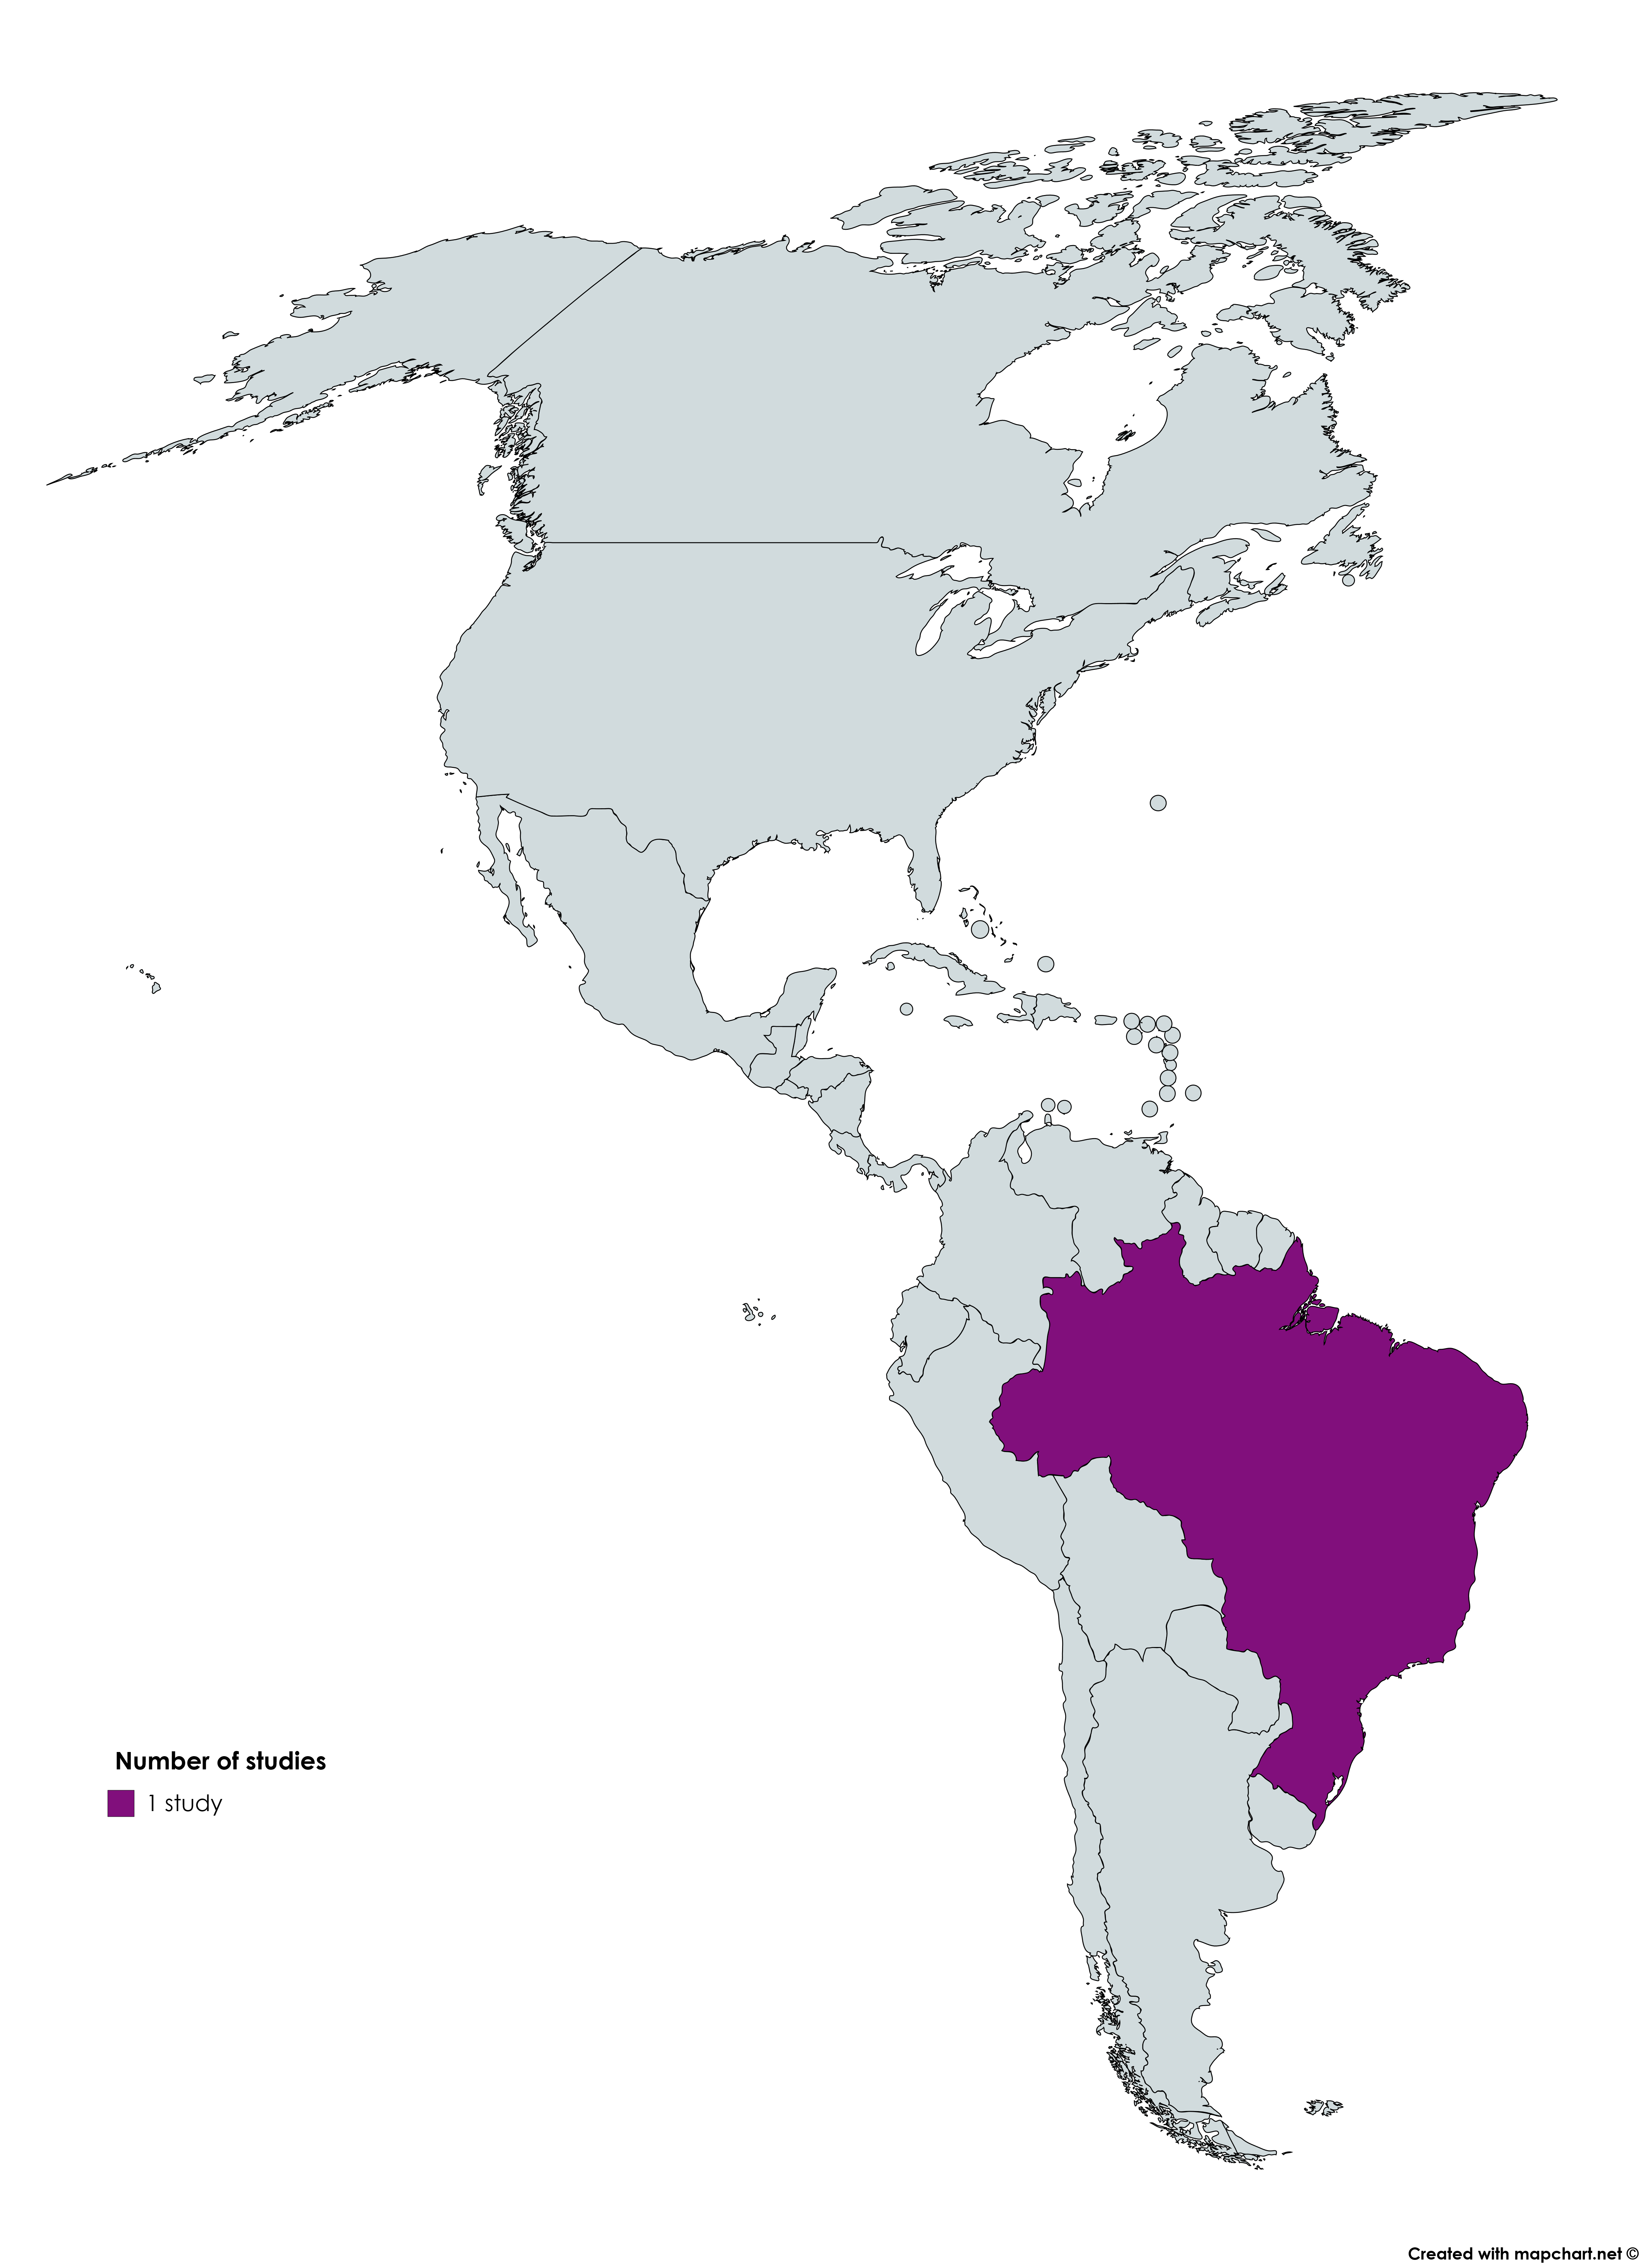
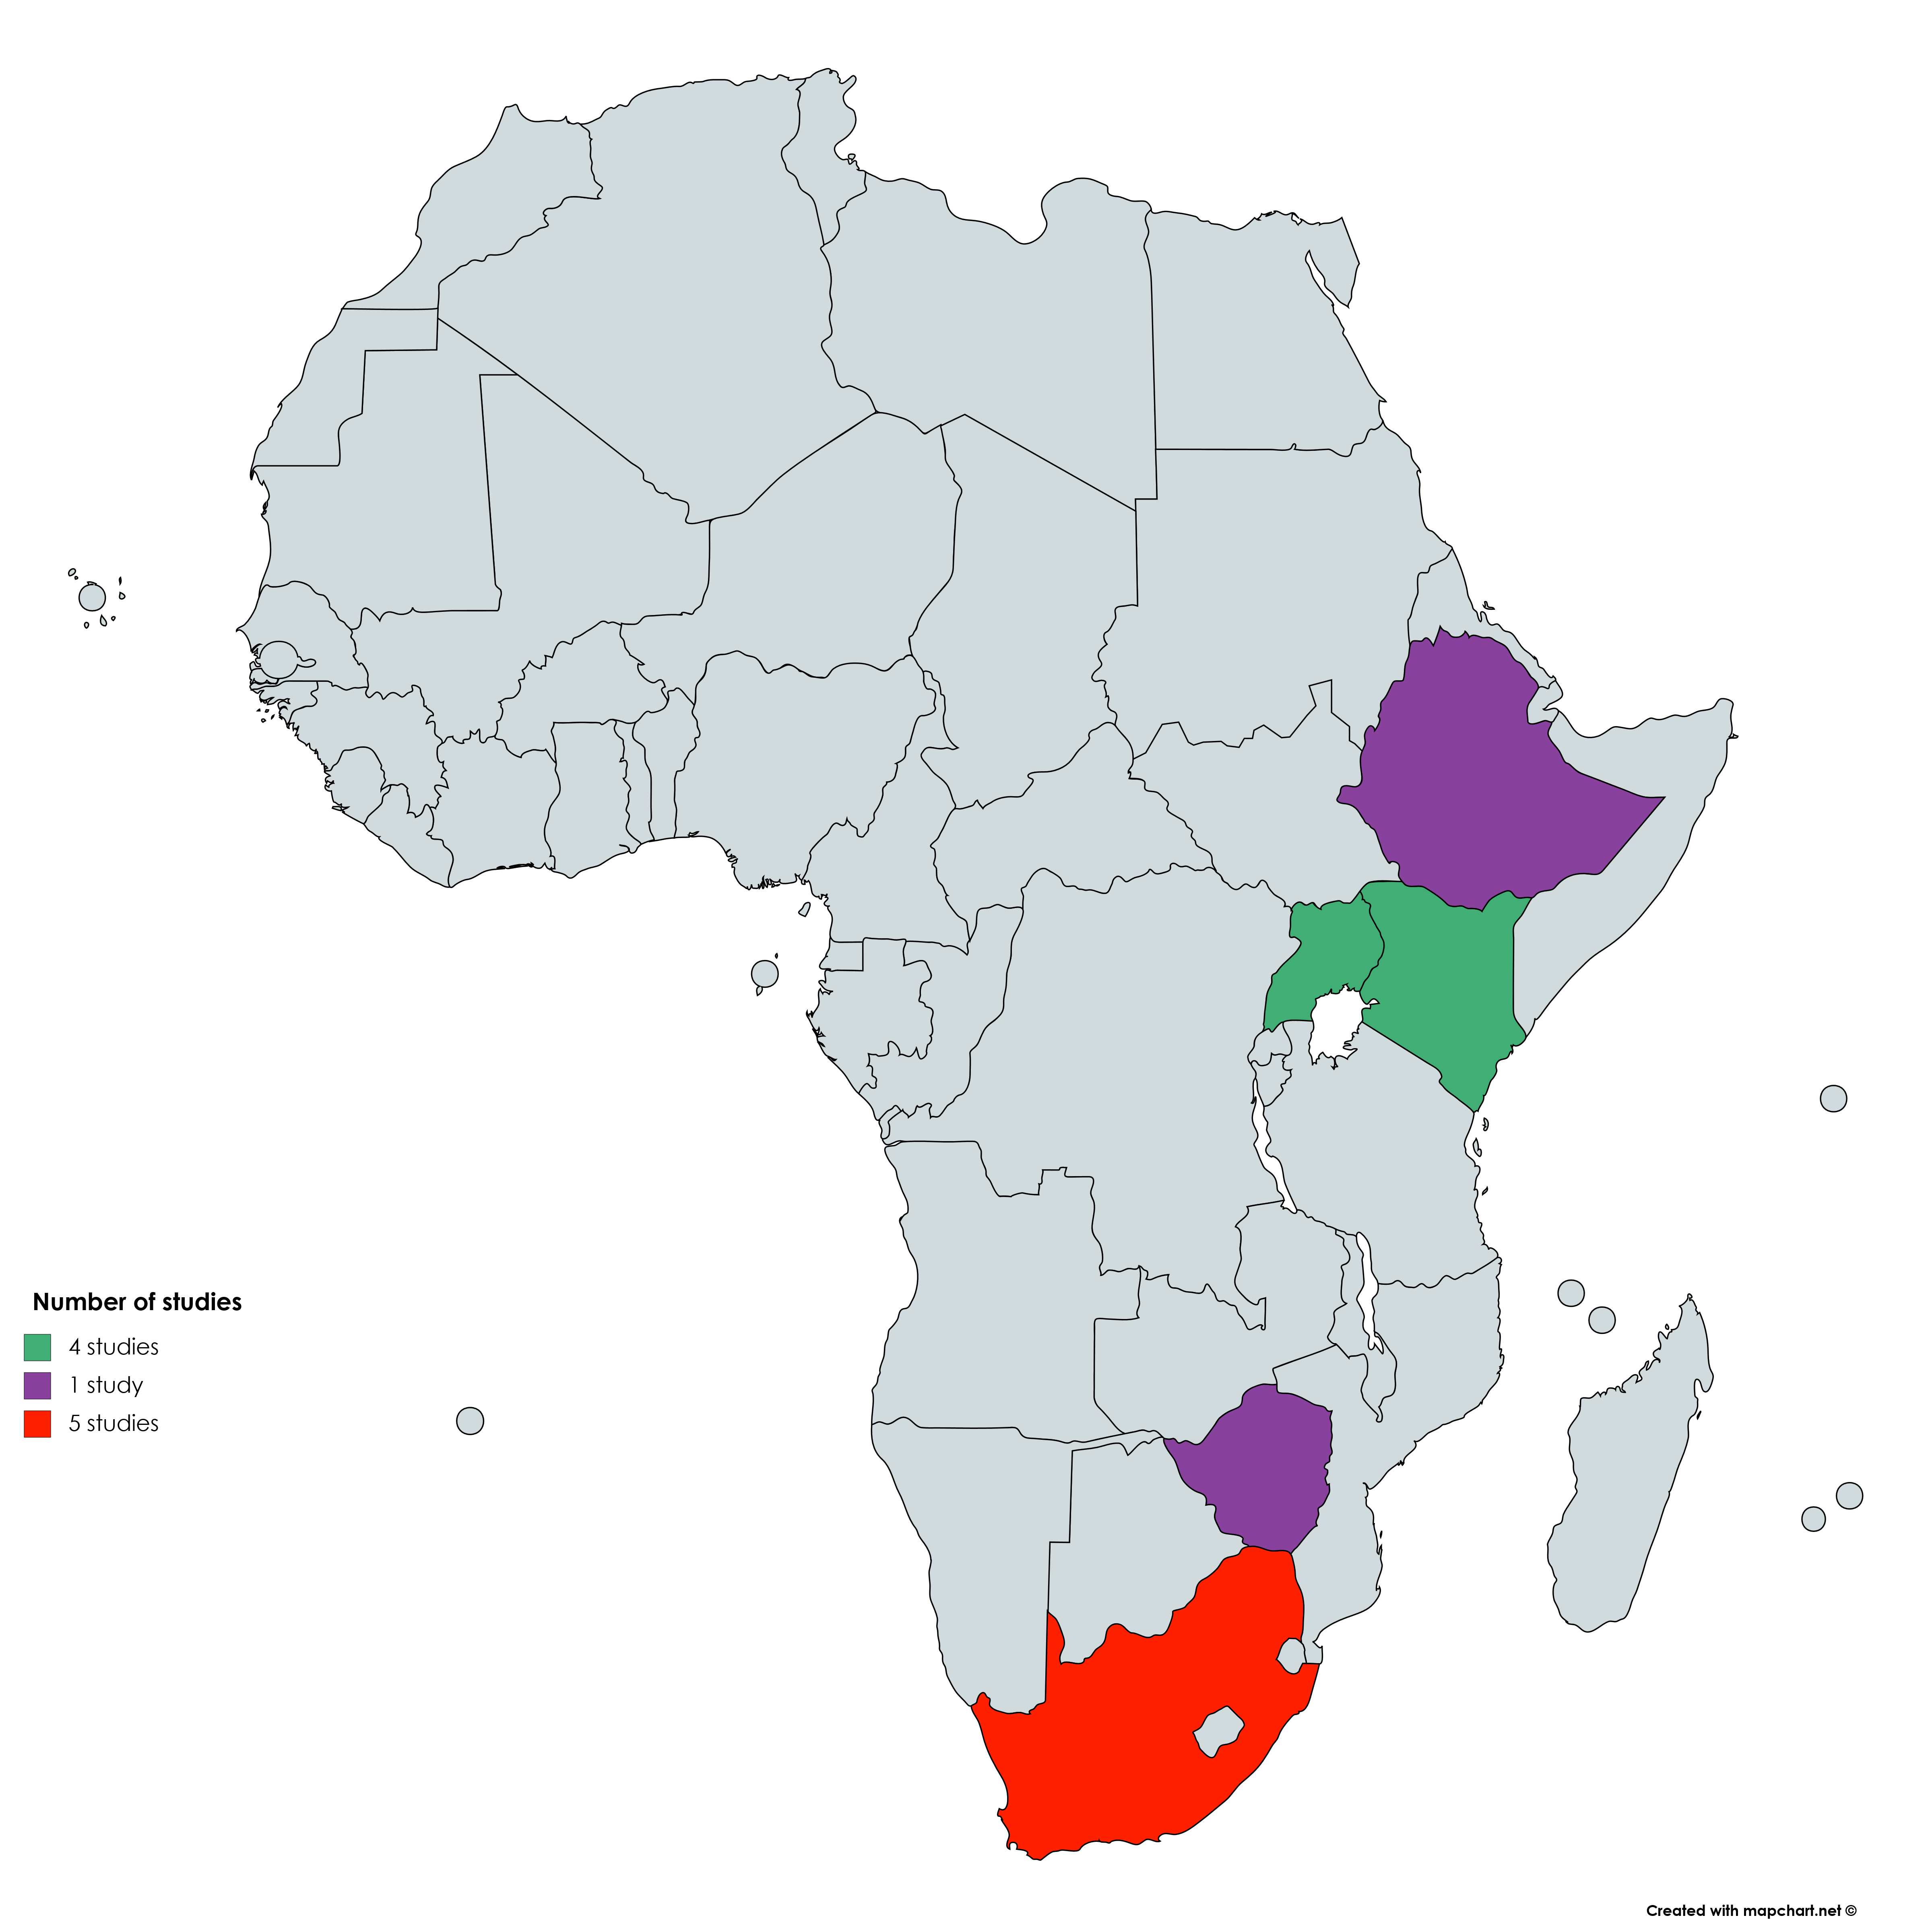
Study distribution

Slide 23
Intervention components

Slide 24
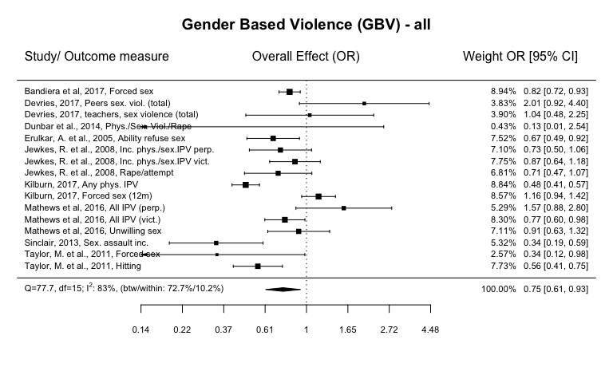
Effects on any GBV – both sexes
Multi-level random effects meta-analysis

Slide 25
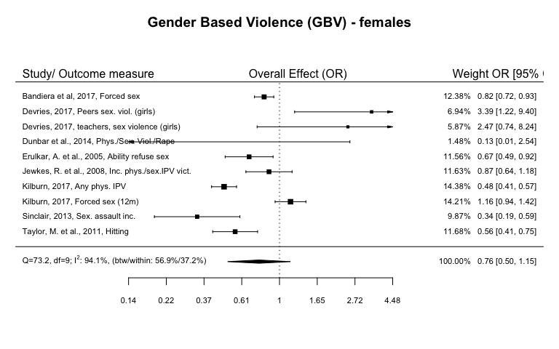
Any GBV females

Slide 26
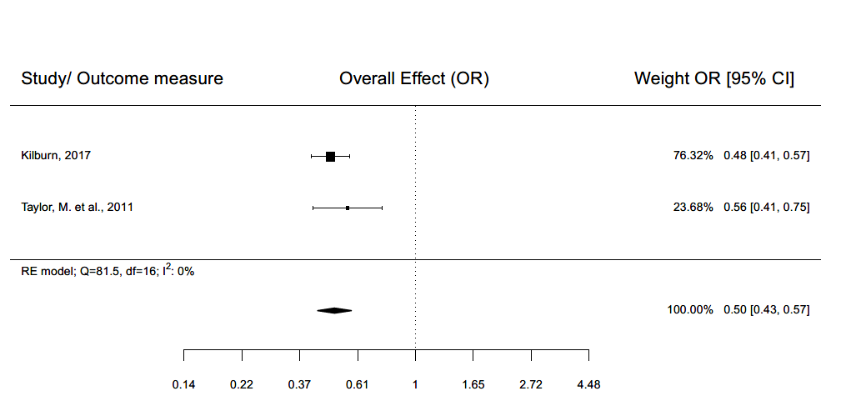
Any physical IPV - female

Slide 27
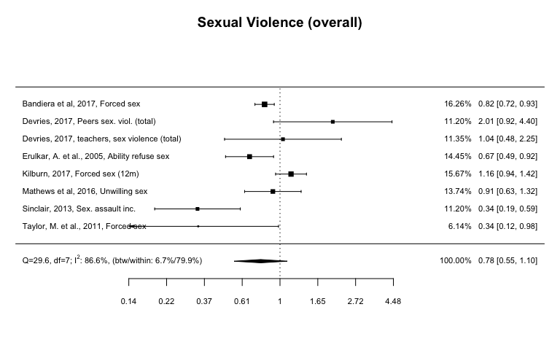
Any sexual violence – both sexes
Multi-level random effects meta-analysis

Slide 28
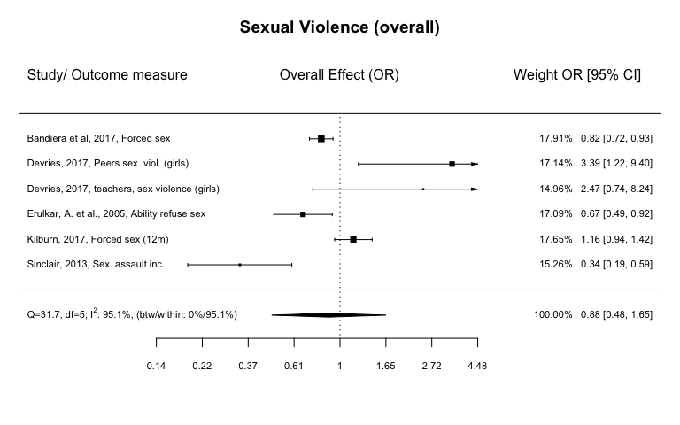
Any sexual violence - female
Any sexual violence – female
Multi-level random effects meta-analysis

Slide 29
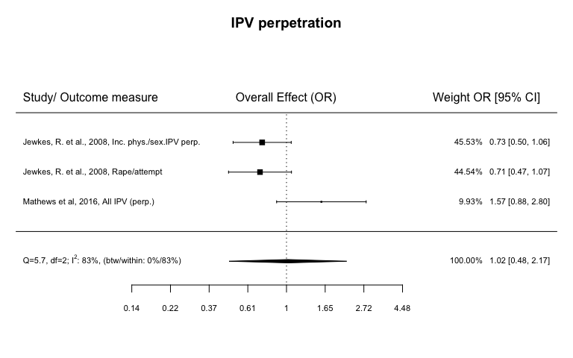
Any IPV perpetration - male
Multi-level random effects meta-analysis

Slide 30
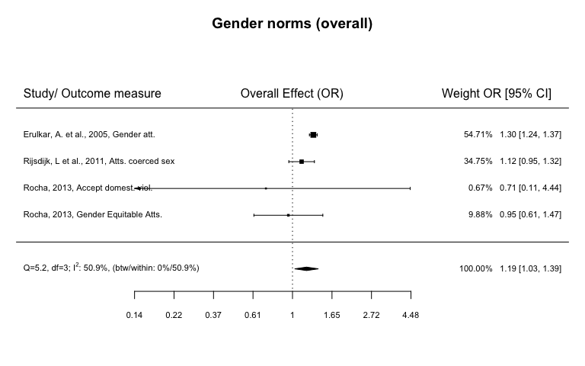
Gender norms – both sexes
Multi-level random effects meta-analysis

